Slide 1
SPECIFICATIONS and DESCRIPTION LANGUAGE (SDL)
Group Members:
NAREN PALEP SAMPATH ADDEPALLI
PRADEEP CHAITANYA TIRUMALASETTY
RAGUNANDAN RAO MALANGULLY

Slide 2
INTRODUCTION
More and more systems are real-time, distributed and operates in heterogeneous environments.
As telecommunication grows internationally, equipment from different manufacturers must be able to communicate with each other.
In 1972, the development of SDL started. First version was released in 1976
SDL and Other Languages: SDL has the ability to communicate with other languages like Mobile Switching Center, Abstract Syntax Notation One (ASN.1), Interface Description language (IDL), Tree and Tabular Combined Notation (TTCN)

Slide 3
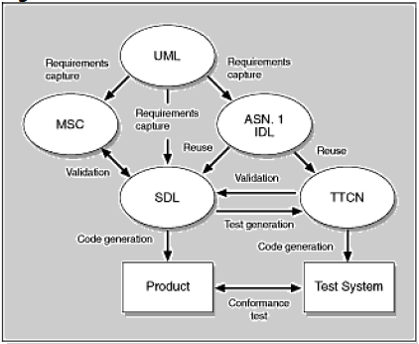
SDL and Other Languages
SDL has the ability to communicate with other languages like Mobile Switching Center, Abstract Syntax Notation One (ASN.1), Interface Description language (IDL), Tree and Tabular Combined Notation (TTCN)

Slide 4
WHY SDL?
Initially in late 1960’s when the experience of first storage program control (SPC) applications in telephony was first felt.
It was a new technology and there were a number of problems in the first exchanges.
These problems are referred to as “Software Problems”.
This situation demanded for solution to solve the above problem.
So, there was an urge for telephony-oriented language.
A proposal came in front to the CCITT in 1968, regarding the problem and the question was assigned to SG XI.
The result to that question, were two different languages: High-level, Telephony-oriented Programming Language.

Slide 5
PROGRESS
The period 1968-1972 was mainly about what to study and the result of it was “CCITT language family”.
The next study was basic SDL, the language becoming not exactly defined but the general principles were agreed upon.
The result was recommendation Z101-Z104 approved by CCITT in 1976.
The following study from 1977-1980 resolved few problems and it became extensively used in CCITT and by manufacturers and administrators.
The new recommendations were approved by CCITT in 1980. This new approved was being used in the telephony exchange.

Slide 6
SDL TERMINOLOGY
It is a modern object oriented language that allows the definition of the distributed systems.
These telecommunication systems communicate each other by means of signals.
In our current scope SDL Signals represents the events of the simulation model.
SDL based on 4 levels to describe the structure and behavior of the telecommunication system. They are:

Slide 7
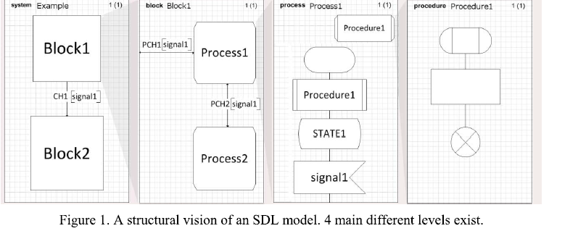
SDL TERMINOLOGY

Slide 8
SDL TERMINOLOGY
SYSTEM
BLOCK
PROCESS
PROCEDURES
In SDL Block and Process are called as AGENTS
The outer most block, the system block is also an agent itself.
This SDL language covers:
System Structure: explains about higherarcy from block to procedures
Communication: established by means of signals and channels
Behavior: defined by different process

Slide 9
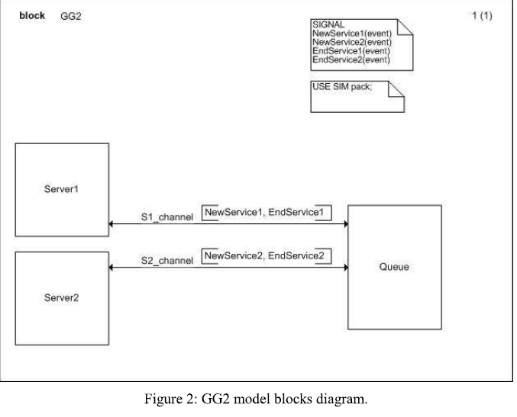
DATA
Inheritance: Describe relationship between objects and their properties
SDL can be represented in either textual or graphical

Slide 10
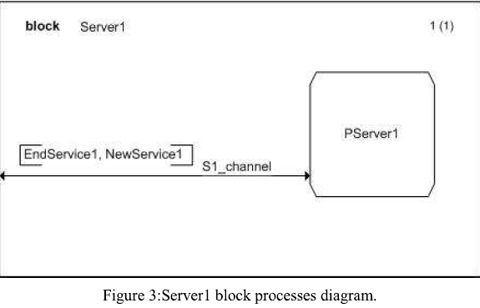
DATA
This diagram explains the structure of the model.
Here we have signals that travel from one agent to another allowing the communication as New Service 1, New Service 2, End Service 1, and End Service 2.
We can further analyze what is happening in the blocks. So we decompose blocks.

Slide 11
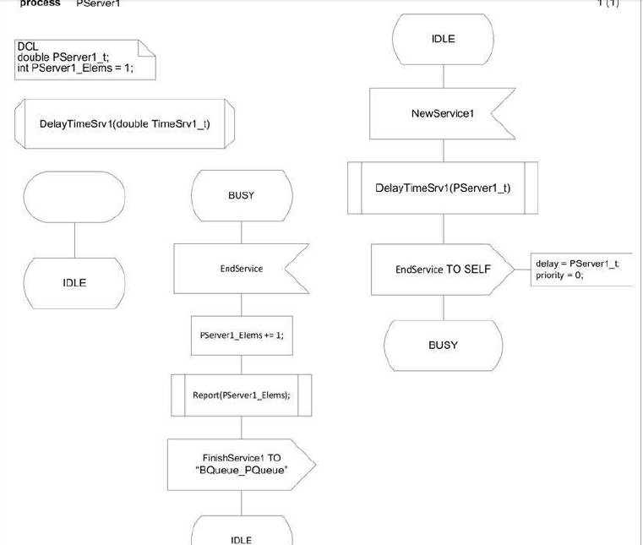
PROCESS DIAGRAM OF THE SERVER

Slide 12
SDL Implementation
Fundamental model of an SDL specification is communicating extended state machines.
SDL language can be explained using :
Structural Concepts
Dynamic Behavioral Concepts
Data Concepts

Slide 13
Structural Concepts
SDL has the ability to describe the static structure of a specification.
anything within the system boundary is within the specification or description.
Structural Concepts contains BLOCKS and CHANNELS which form a functional entities of the system to be composed and communication between these entities.
a channel is a carrier of two or more signals.
it may be unidirectional or bidirectional.
in Figure 1 , traffic is structured into two blocks traffic_control_centre and local_control.
communication between these two blocks is done through tcc_lc channel.

Slide 14
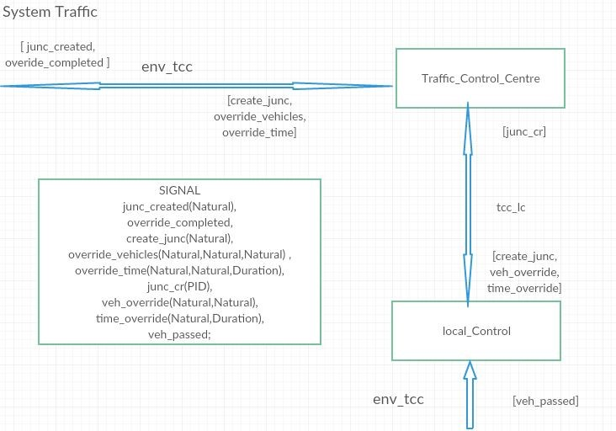

Slide 15
BLOCK facilitates further structuring of a system by means of a block diagram.
SIGNAL carry information as parameters.
Processes can be created at the start of system invocation or they can be created dynamically by another process within the same block.
in figure 2, process junction dynamically creates process light_controller.
SDL enables multiple instances of a process type to be specified.

Slide 16
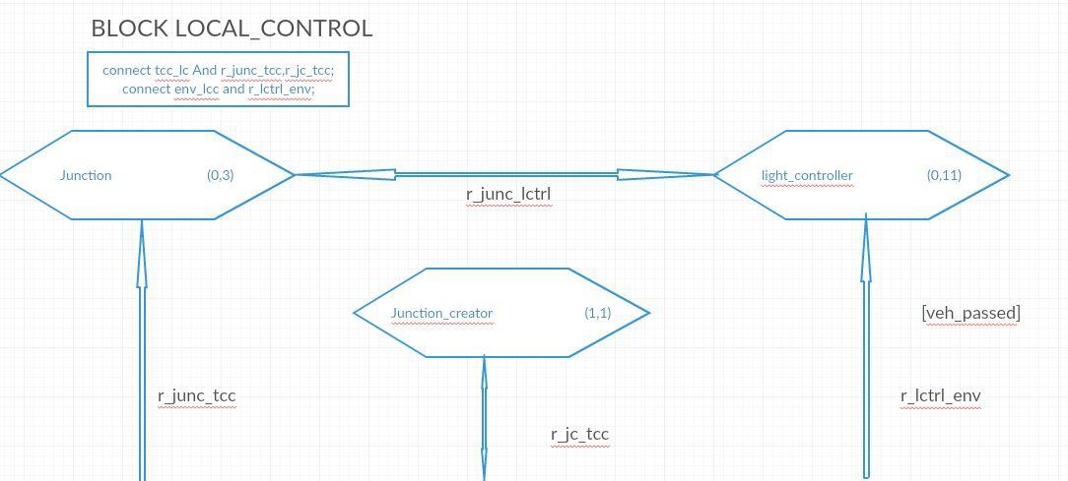

Slide 17
Dynamic Concepts
process graphs describe the dynamic behavior of a system.
in a process graph, start node indicates the point at which interpretation of process begins.
process has the ability to do :
receive signals
preserve signals for process in a later state
call macros
call procedures
reveal variables to another process
create other processes
show the variable of another process
export its own variables
import the variable of other process
make decisions on data
change and set timers

Slide 18
DATACONCEPTS
Data can be defined anywhere in a SDL system.all data is defined within a text symbol.
Data types are distinguished into user defined or predefined.
the predefined data types in SDL are boolean , character , Integer , Natural ,Real , Pid (process Identifer) , Duration (Of Time) , Time and CharString.the user defined types are referred to as new types.
in figure 3,newtype sequence_record is defined.this is a structure with fields of type Natural,Duration and Pid.
SDL descriptions can be defined using formal data definitions or informal text.
example of a formal text is 'expression a := a+1' .
example of a informal text is 'increment a by 1' .

Slide 19
Advantages
More Secure Software: Unambiguous, clear, precise and concise specifications
Help Address Compliance Requirements: basis of determining whether or not an implementation conforms to the specifications
Reduce Costs: No expensive tools required. Text processor would suffice.
Reducing coding effort: Computer support for generating applications without the need for the traditional coding.
Validating requirements: basis for determining the consistency of specifications

Slide 20
Disadvantages
Integration: Increased difficulty of integrating the SDL with other components of the system.
Weak Knowledge repository: Harder to find code examples.
Inefficient usage of resources: Potential loss of processor efficiency compared with hand-coded software.
Fewer skilled people: Requires training non skilled people.

Slide 21
Tools using SDL
Rational SDL Suite – IBM acquired from Telelogic, tool for SDL generation.
Real Time Developer Studio - PragmaDev, to support Real time SDL generation.
Sandrila SDL - Add-in for Microsoft Visio for SDL, UML generation.
SDL Integrated Tool Environment - open development environment and analysis components for SDL

Slide 22
Thank you

